Slide 1


Exploring the Dynamics of Real Estate Market in King County
22th July 2024
Moringa School – Data Science Class 2024
Group Members
Bennie Kibet
Victor Muuo
Chemutai Annolyne
Josphat Wanjiru
Eric Rono
Gladys Mosota
group git url: https://github.com/Bennie-Kibet/Phase-2-project.git

Slide 2
INTRODUCTION
Project Background
This project involves using regression modeling to analyze house sales data from King County. The aim is to provide insights into the housing market and offer actionable recommendations for stakeholders, particularly focusing on advising homeowners on how renovations might increase their home's value.

Slide 3
OVERVIEW
The King County Housing Data Set provides information about houses in King County, including their size, location, condition, and other features. The objective of this project is to create a multiple regression model that can accurately predict the price of a house.
The project is commissioned by a commercial real estate company interested in purchasing homes within a specific area. Their main concerns revolve around obtaining predicted prices for homes in the area, and assessing any notable disparities between the actual prices and our model's predicted prices.

Slide 4
BUSINESS UNDERSTANDING
G4 Real Estate Agency wants to venture into the business of buying and selling houses in King County. The real estate agency intends to leverage comprehensive real estate data, including historical sales and property features to model the dynamics of the property value based on regression analysis. The model will identify key price-influencing factors. Once integrated, the model will provide reliable estimates, aiding informed property transactions. With this understanding the agency will become a trusted source in the local market, attracting a loyal customer base.

Slide 5
OBJECTIVES
Using the King County House Sales dataset, the primary objective is to analyze and understand factors influencing house prices. The specific objectives are:
Identify Key Determinants: Determine which house features significantly impact prices in King County.
Analyze Size Impact: Investigate if larger houses tend to have higher prices.
Develop Prediction Model: Create and evaluate a multiple linear regression model to predict house prices using key determinants, assessing performance with metrics like R-squared, MSE, and MAE.

Slide 6
KEY QUESTIONS
Question 1. What are the key determinants of house prices in King County?
Question 2. Do larger houses tend to have higher prices in King County?
Question 3: What is the best linear regression Model for Predicting house prices?

Slide 7
BUSINESS PROBLEM
G4 Real Estate faces challenge in effectively entering the dynamic King County real estate market due to the complex interplay of factors influencing housing prices and demand.
Understanding the intricate relationship between property features, seasonal trends, and market dynamics is crucial for developing successful market penetration and growth strategies.

Slide 8
METHODOLOGY
Data Understanding
Data Cleaning
Handling Missing Values: Filling in or removing missing data.
Removing Duplicates: Eliminating duplicate entries.
Correcting Errors: Fixing typos and inconsistent formats.
Feature Engineering
Data Transformation: Converting data to appropriate formats.
Exploratory Data Analysis (EDA)
Outlier Detection: Identifying and addressing outliers.
Modelling
Linear Regression Model
Model Validation

Slide 9
Data Overview
Data Understanding
The King County Housing Data Set provides information about houses in King County
The dataset `kc_house_data.csv` contains various features related to house sales in King County. The features include information on house characteristics, location, and sale details.

Slide 10
Column Descriptions
Data Understanding Cont’d…
Key columns Names and descriptions for Kings County Data Set include:
id - unique identified for a house
Date - house was sold
Price - is prediction target
bedroomsNumber - of Bedrooms/House
bathroomsNumber - of bathrooms/bedrooms
sqft_livingsquare - footage of the home
sqft_lotsquare - footage of the lot
floorsTotal - floors (levels) in house
waterfront - House which has a view to a waterfront
view - Has been viewed
condition - How good the condition is (Overall)
grade - overall grade given to the housing unit, based on King County grading system
sqft_above - square footage of house apart from basement
sqft_basement - square footage of the basement
yr_built - Built Year
yr_renovated - Year when house was renovated
zipcode - zip
lat - Latitude coordinate
long - Longitude coordinate
sqft_living15 - The square footage of interior housing living space for the nearest 15 neighbors
sqft_lot15 - The square footage of the land lots of the nearest 15 neighbors

Slide 11
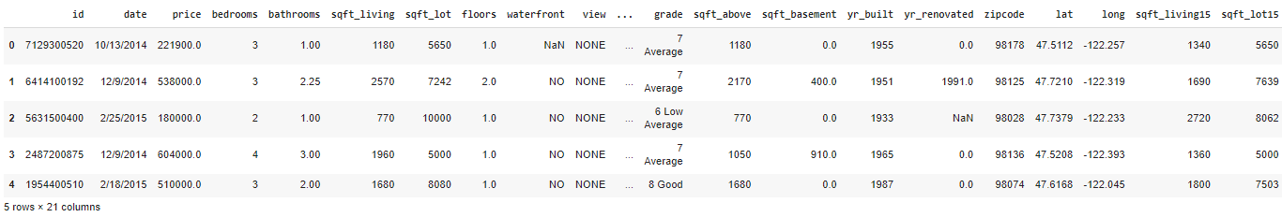
Data Understanding Cont’d…
Sample of the raw DataSet

Slide 12
Observations:
Data Understanding Cont’d…
The King County Data Set comprises 21,597 entries and 21 columns, each describing various attributes of houses sold in the area. Key columns include a unique house identifier, the sale date, and the sale price (prediction target).
Other features cover the number of bedrooms and bathrooms, square footage of the living area and lot, number of floors, and whether the house has a waterfront view.
The dataset also includes columns for the house's condition, grade, square footage above ground and in the basement, year built, year renovated, zip code, latitude, and longitude. Additionally, it provides information on the living space and lot size of the nearest 15 neighbors.

Slide 13
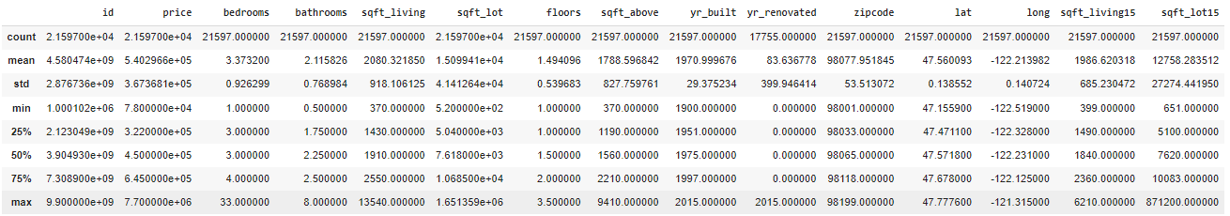
Data Understanding Cont’d…
Descriptive statistics

Slide 14
Data Understanding Cont’d…
Descriptive statistics
The price column seems to be the price since the last sale. This could be out-of-date if a long time has passed since the last sale. Therefore, we should create two features:
Age of the home
Number of years since the last sale
sqft_living15 appears to be the average living space of the 15 nearest properties, while sqft_lot15 seems to be the average lot size of the 15 nearest lots.
The data pertains to houses in zip codes around Seattle, WA.
The dependent variable is price, with values ranging from $78,000 to $7,700,000, a mean of $540,296, and a median of $450,000.
sqft_living ranges from 370 to 13,540 square feet.
bedrooms range from 1 to 33, with a mean of 3.37 and a median of 3.
sqft_lot ranges from 520 to 1,651,359 square feet, with a mean of 15,099 and a median of 7,618.
The dataset includes 70 zip codes.
grade ranges from 3 to 13, based on the King County grading system.
condition ranges from 1 to 5, with 5 being the best.
view indicates the number of times a house has been viewed, ranging from 0 to 4.
waterfront indicates whether the house has a waterfront view, with 0 meaning no and 1 meaning yes.

Slide 15
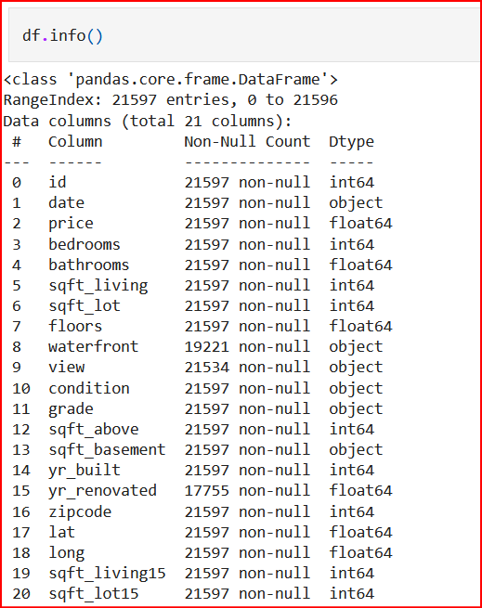
DATA CLEANING
The dataset has notable missing values: 2,376 for waterfront, 63 for view, and 3,842 for year renovated, highlighting the need to address these gaps for accurate analysis.
The percentage of missing values for the year renovated is significantly high at 17%, which would greatly affect the dataset. Therefore, these missing values are replaced with the most occurring value in the column, which is zero (0).
Null values account for 11% of the dataset, a significant percentage. Instead of dropping them, the missing values for the waterfront column were replaced by the modal value of waterfronts for all houses that share the same zip code. This method effectively imputes missing data based on the most frequent value within each specified group (zip codes).

Slide 16
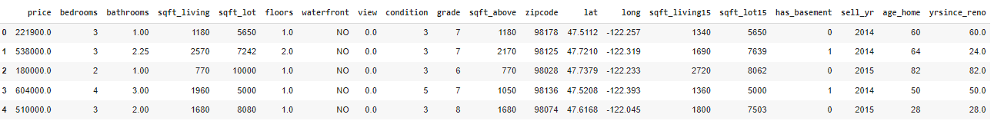
Cleaned Dataset
DATA CLEANING Cont’d…
This cleaned dataset ensures that all missing values have been handled appropriately. The columns now include detailed information about the properties, which can be used for further exploratory data analysis and predictive modeling.

Slide 17
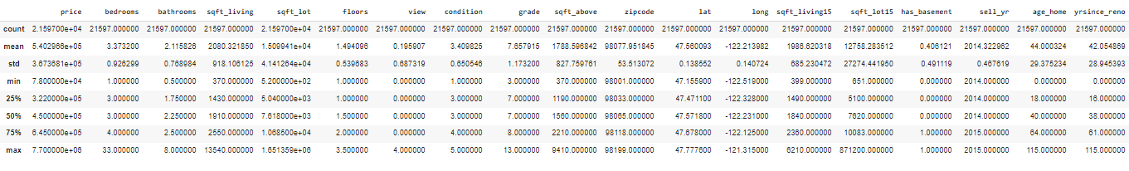
Key statistics of the cleaned data:
EXPLORATORY DATA ANALYSIS Cont’d…
Price (Target Variable)
The high standard deviation indicates a broad range of house prices.
The median (50th percentile) is lower than the mean, suggesting potential positive skewness, which is typical in house price distributions.
To address this skewness and potentially enhance model performance, we will consider applying a log transformation to the price variable.
Next, we will investigate the relationships between the features and the target variable.

Slide 18
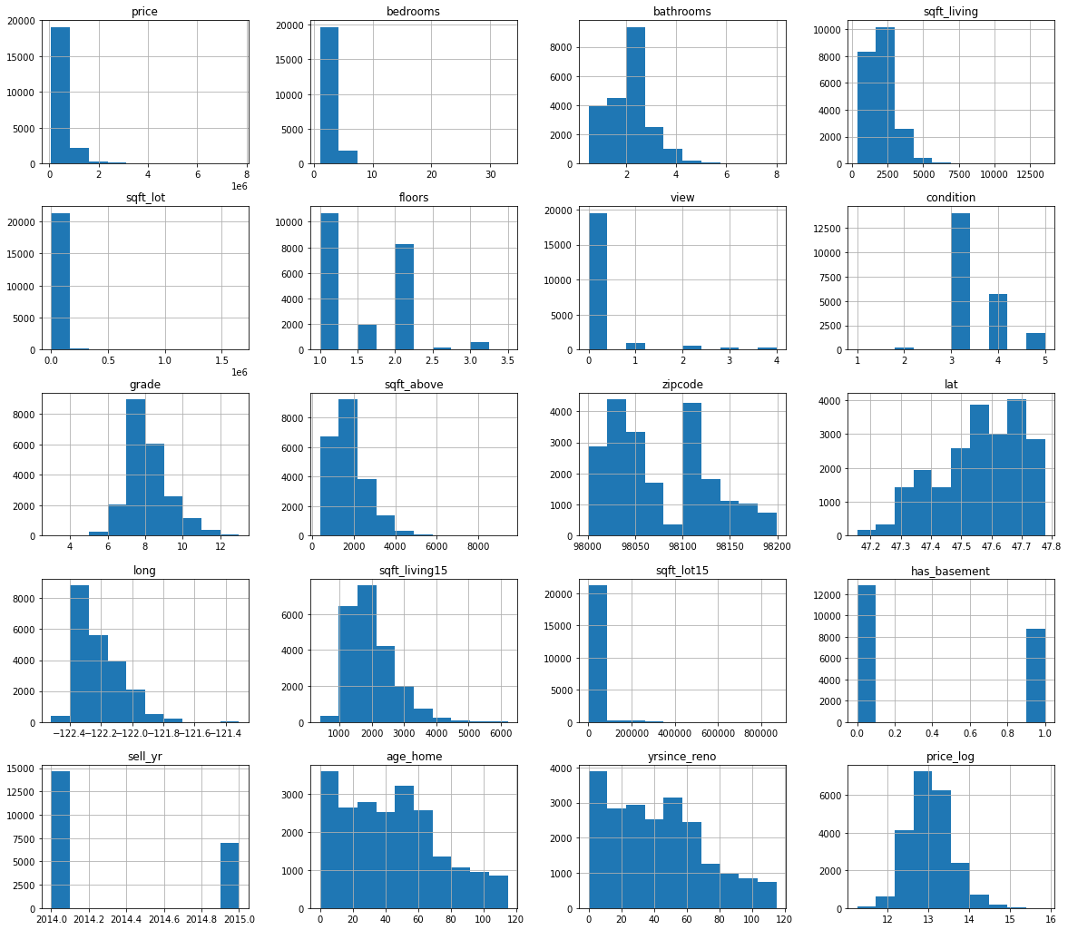
HISTOGRAMS
EXPLORATORY DATA ANALYSIS Cont’d…
Frequency distribution of features in the king county dataset

Slide 19
Observations from the Histograms
EXPLORATORY DATA ANALYSIS Cont’d…
1. Skewness:
Positive Skewness: Many features such as price, sqft_living, sqft_lot, etc., exhibit positive skewness. This means that there are a few extremely high values that are pulling the tail of the distribution to the right. This is evident from the long right tails in the histograms for these features.
Example: In the price histogram, most values are concentrated on the left side, with a few extremely high prices extending to the right.
2. Outliers:
Presence of Outliers: Some features might contain outliers, which are data points that deviate significantly from the overall pattern of the data. Features such as price, sqft_living, and sqft_lot likely have outliers.
Example: In the sqft_lot histogram, there are a few properties with extremely large lot sizes that are far from the majority of the data points.

Slide 20
Observations from the Histograms
EXPLORATORY DATA ANALYSIS Cont’d…
3. Multimodality:
Multiple Clusters: Some features, like zipcode, might exhibit multimodality, indicating the presence of multiple clusters or groups within the data. This can be seen in the histograms where there are multiple peaks.
Example: The zipcode histogram shows multiple peaks, suggesting that properties are distributed across different geographic clusters.
4. Range:
Wide Range: The range of values for each feature varies significantly. Some features, like price and sqft_living, have a wide range of values, while others, like floors and waterfront, have a narrower range.
Example: The price histogram spans from low to very high values, indicating a wide range of property prices.

Slide 21
EXPLORATORY DATA ANALYSIS Cont’d…
These observations highlight the importance of understanding the distribution and characteristics of each feature in the dataset. Handling skewness, outliers, and multimodality appropriately can lead to more improved and meaningful analysis.
Before proceeding with the analysis of the most affected features, it is essential to handle the necessary outliers. Outliers can significantly impact the results of the analysis and may need to be treated appropriately, such as through removal or transformation.

Slide 22
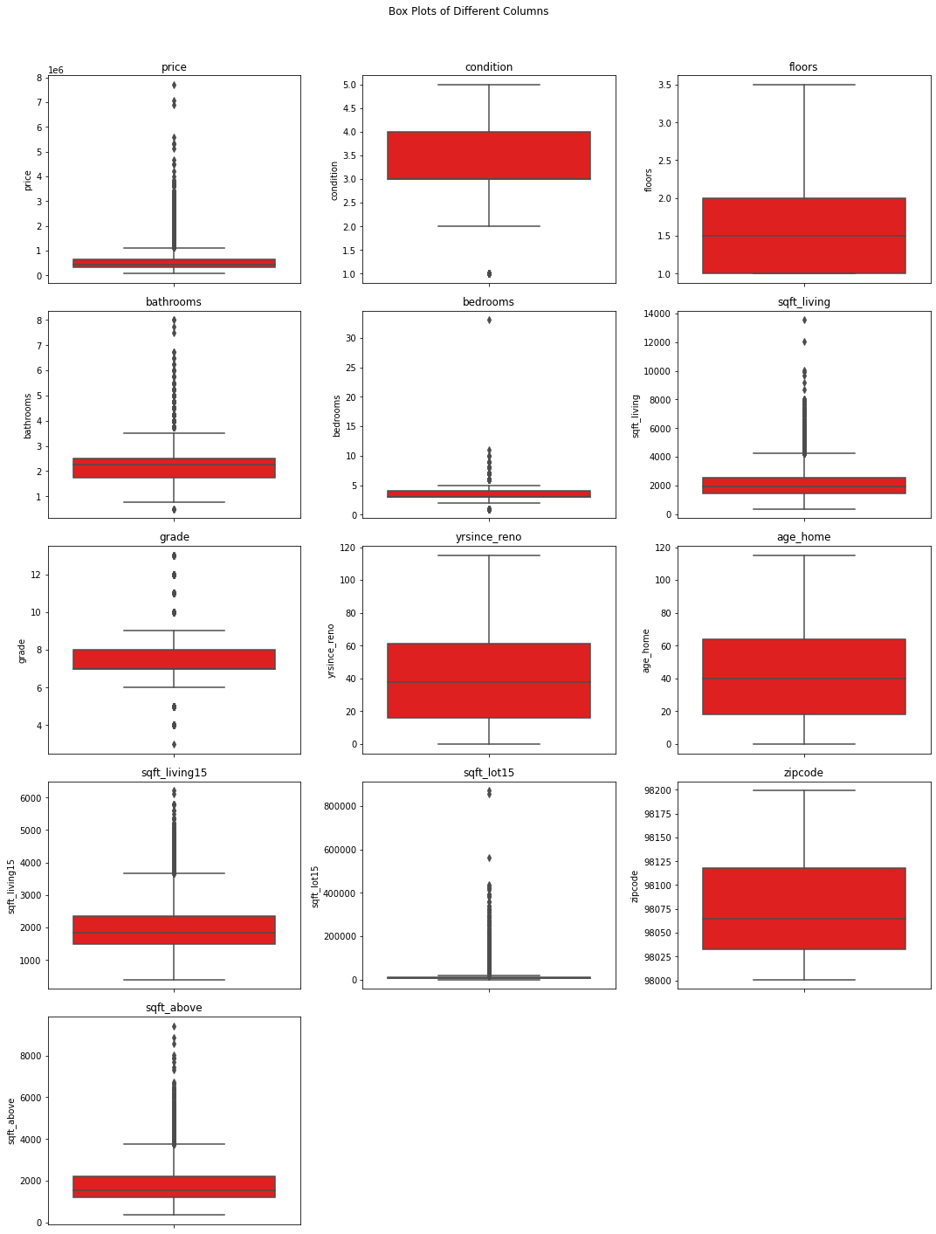
Checking for Outliers Box Plots - Observation
One house has an extraneous value of 33 bedrooms. The value is replace by the median value all houses with the corresponding zip codes
Observations on Features
Price: Many high-priced outliers.
Bedrooms: Few outliers with high bedroom counts.
Sqft_living and Sqft_lot: Multiple large house outliers.
Waterfront: Outliers with unique characteristics.
View: Properties with exceptional views.
Grade: High-grade property outliers.
Sqft_above and Sqft_basement: Large area outliers.
Given the real data, we will retain outliers for accurate insights.

Slide 23
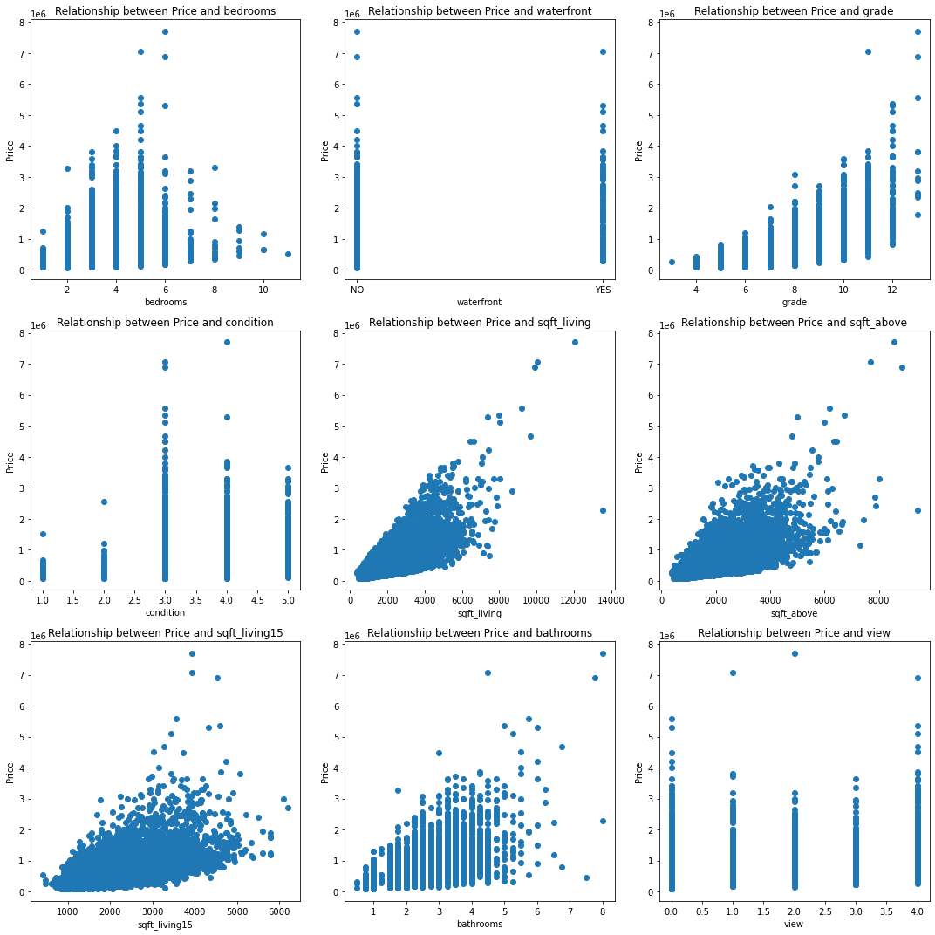
Bivariate Analysis
Bivariate analysis was carried out to examine the relationship between the target variable - price and the other numeric and continuous features in the data
Scatter plots were generated to show the direction, strength, and shape of the relationship between two numeric variables.
This was used in understanding how one variable affects or is affected by another variable and identify any patterns or trends that may exist.

Slide 24
Observations
Price vs. Sqft Living Area: Positive correlation; larger homes are generally more valuable.
Price vs. Bedrooms/Bathrooms: More bedrooms/bathrooms typically mean higher prices, though not linearly.
Price vs. Grade/Condition: Higher grade and better condition homes command higher prices.
Price vs. Location: Certain zip codes have higher house prices, highlighting the importance of location.

Slide 25
Insights from Scatter Plots
Bedrooms: More bedrooms usually mean higher prices.
Waterfront: Waterfront properties are more expensive.
Grade: Higher-grade houses are pricier.
Condition: Better-conditioned houses are valued higher.
Sqft Living: More living space increases house price.
Sqft Above: Larger above-ground areas correlate with higher prices.
Sqft Living 15: Houses larger 15 years ago are more expensive today.
Bathrooms: More bathrooms correlate with higher prices.
View: Better views generally increase house price, but the relationship is weaker.
These insights aid in making informed property investment decisions.

Slide 26
Multivariate analysis
In this section, we performed multivariate analysis to examine the relationship between the target variable - price and multiple features in the data. We used heatmap to visualize the correlation matrix of the features and see how they are related to each other and to the price.
A heatmap shows the strength and direction of the correlation between two variables using different colors and shades. This was used to identify the most important features for the prediction and avoidance of multicollinearity.

Slide 27
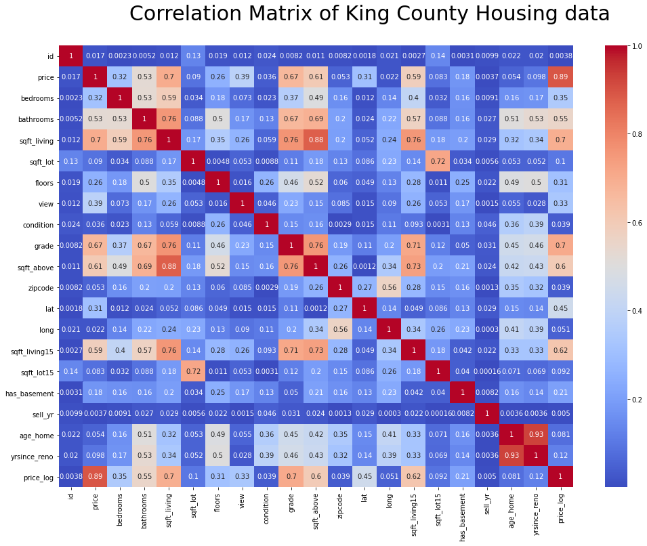
Correlation Matrix
The correlation matrix shows the correlations between different features in the dataset. Features with high positive or negative correlations are identified as having significant relationships.

Slide 28
From the correlation matrix features that has moderate to high correlation with price_log include:
sqft_living: Strong positive correlation with price (0.70), indicating larger homes are more expensive.
sqft_above: Significant positive correlation (0.60), showing the impact of above-ground living area on price.
grade: High correlation (0.70), suggesting higher-graded houses command higher prices.
bathrooms: Moderate positive correlation (0.55), indicating more bathrooms increase property value.
bedrooms: Moderate correlation (0.35), similar to bathrooms.
sqft_living15: Positive correlation (0.62), indicating larger homes are often near other large homes, but sqft_living is prioritized.

Slide 29
Analysis 1. Identify key determinants of house prices:
The key determinants of house prices were determined based on the moderate to high correlation of price_log to other features. The features identified include:
Square foot living
Square foot above
Grade
Bathrooms
Bedrooms
Square foot living for neighboring 15 houses

Slide 30
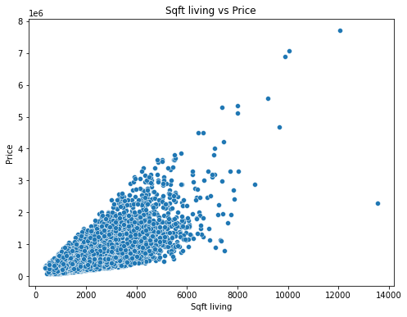
Trend observation
Analysis 2. Investigating whether large houses tend to have higher prices?
Positive Correlation: There is a clear positive correlation between sqft_living and price. As the living area increases, the house price also tends to increase. This is evident from the upward trend in the scatter plot.
Implication
This suggests that larger homes generally command higher prices, which is important for pricing strategies and setting client expectations
Trend observation
Positive Correlation: There is a clear positive correlation between sqft_living and price. As the living area increases, the house price also tends to increase. This is evident from the upward trend in the scatter plot.

Slide 31
Trend observation
Implication
This suggests that larger homes generally command higher prices, which is important for pricing strategies and setting client expectations.
Although there is price variation, smaller houses (with sqft_living below 2,000) have less variation in price compared to larger houses. As the size increases, the variation in price also increases, suggesting that other factors might also play a role in determining the price of larger houses.
Analysis 3: Develop a Linear Regression Model to Predict Housing Prices

Slide 32
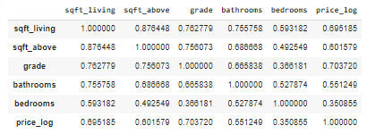
Correlation Matrix of selected features

Slide 33
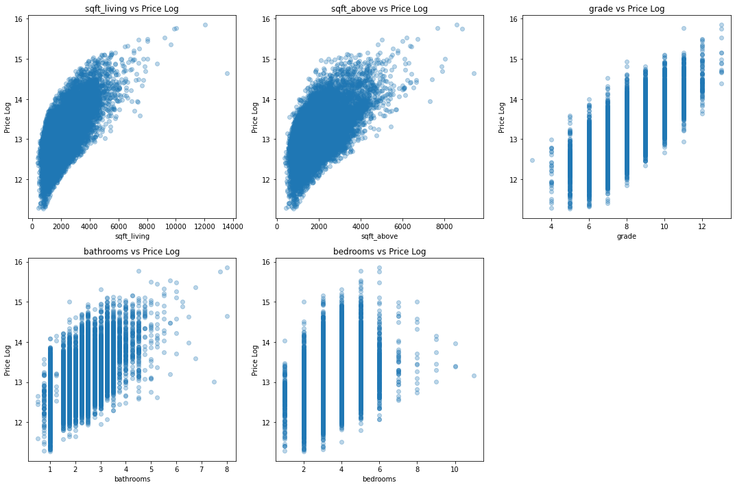
Scatter Plot of Price_Log vs Selected features

Slide 34
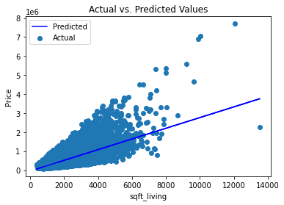
Baseline Linear Regression Model for Predict Housing Prices
MODELLING
We have developed an initial baseline model to predict house prices using the living area (sqft_living) as the sole predictor. While this model explains approximately 47.3% of the variance in house prices, there is significant room for improvement. The model's predictions have an average error (MAE) of approximately 0.311 units, and the overall accuracy can be enhanced by considering additional factors.

Slide 35
MODELLING Cont’d…
Model 1
Model 1 was an improvement to the baseline model with an improved r squared value of 56.9%.
Features added in this model include:
sqft_living, sqft_above, grade, bathrooms, and bedrooms.
Model Parameters:
mse: 0.120
mae: 0.276
r2: 0.569

Slide 36
MODELLING Cont’d…
Model 2
Model 2 was an improvement to the model 1 with an improved r squared value of 63.3%.
Features added in this model include both numeric and categorical features:
sqft_living, sqft_above, grade, bathrooms, bedrooms, condition, year since renovated, basement
Model Parameters:
mse: 0.102
mae: 0.253
r2: 0.633

Slide 37
MODELLING Cont’d…
Model 3
Model 3 was best model with the highest r squared of 0.74 which explains 74.6% of the variance in house prices being influenced by the selected features.
The model's predictions has considerably improved with an average error (MAE) of approximately 0.199 units,
The selected features added in this model include both numeric and categorical features. They include:
sqft_living, sqft_living15, sqft_above, grade, bathrooms, bedrooms, condition, year since renovated, basement, age_home, latitude, longitude, zipcode
Model Parameters:
mse: 0.064
mae: 0.199
r2: 0.746

Slide 38
MODELLING Cont’d…
Summary of Model parameter
Model | Baseline Model | Model_1 | Model_2 | Model_3
MSE | 0.146 | 0.120 | 0.102 | 0.064
MAE | 0.311 | 0.276 | 0.252 | 0.199
R-Squared | 0.473 | 0.569 | 0.633 | 0.746

Slide 39
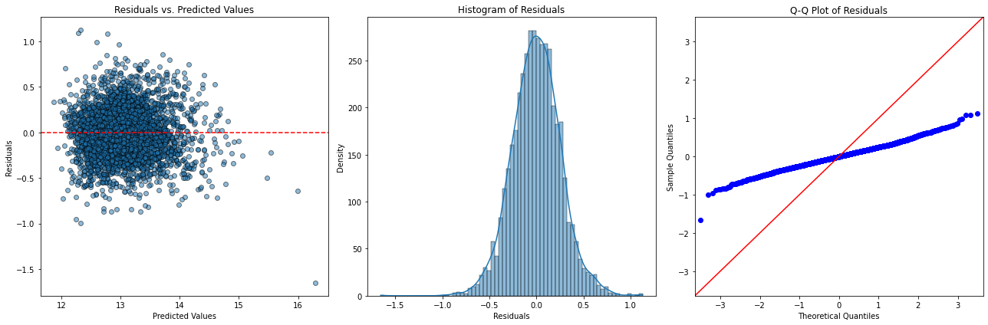
MODEL VALIDATION
Conclusions
Model Performance: The model appears to be well-fitting based on the diagnostic plots. The residuals are randomly scattered around zero, and both the histogram and Q-Q plot suggest that residuals are normally distributed.
Model Adequacy: Given these results, the log-transformed price model is effective and satisfies the key assumptions of linear regression
This process ensures a thorough evaluation of the linear regression model by considering additional features and conducting diagnostic checks to validate the model's assumptions and performance.

Slide 40
CONCLUSION
Objective 1:
Identify Key Determinants of House Price
Findings:
Key determinants of house prices in King County include:
sqft_living
sqft_above
grade
bathrooms
bedrooms
sqft_living and grade have the strongest correlations with house prices (0.7 each), indicating a moderate to strong positive relationship.
Implication:
Larger living areas (sqft_living) significantly increase house prices, reflecting buyer preference for spacious homes.
Higher grade ratings, indicating superior quality and design, are linked to higher property values.
Other features like sqft_above (upper floors area), number of bathrooms, and bedrooms also influence house prices but to a lesser extent.
These insights help stakeholders in the King County housing market better evaluate property values and investment opportunities.

Slide 41
CONCLUSION Cont’d…
Objective 2:
Investigating Whether Large Houses Tend to Have Higher Prices
Findings:
The Linear Regression model reveals a strong relationship between sqft_living and house prices in King County.
The scatter plot and regression line illustrate this correlation.
An R-squared value of 0.473 indicates that 47.3% of the variability in house prices is explained by sqft_living.
As sqft_living increases, house prices rise, as highlighted by the model's positive coefficient.
Implications:
Buyers place significant value on larger living areas, demonstrated by the positive correlation with house prices.
Properties with more spacious interiors are likely to command higher prices in the market.
This insight is crucial for stakeholders in the real estate market to make informed decisions regarding property valuations and investments.

Slide 42
CONCLUSION Cont’d…
Objective 3: Develop a Linear Regression Model to Predict Housing Prices
conclusion:
Findings: The best fit linear regression model, incorporating features contained in model 3, achieves an R-squared (R2) score of 0.76 on the test set. This indicates that 76% of the variance in housing prices can be explained by these predictors.
Implications The robust Linear Regression model offers G4 real estate operating in King County a powerful tool for estimating housing prices based on property characteristics like sqft_living. This predictive capability will enable G4 real estate provide informed advice to buyers and investors thereby facilitating strategic decisions on property purchases and investment potential.

Slide 43
RECOMMENDATIONS
Evaluate Property Potential: When evaluating properties, focus on the sqft_living as a key determinant of market value. Consider developing or investing in properties with larger living spaces as these would fetch them higher returns
Market Positioning: Use the insight gained from the regression analysis to strategically position properties in the market. Highlight larger living areas as a selling point that can justify higher asking prices or premium listings
Continuous Improvement: The model, while robust, can always be refined further. Continuous data collection and model updates can help maintain and potentially improve accuracy over time

Slide 44

THANK YOU

